Slide 1
CE (C-II) CIVIL ZONE
1. ACHIEVEMENT/ COMPLETED PROJECTS IN THE FY 2021-22
2. WORK TARGET/BUDGET ANNOUNCEMENT/ONGOING WORK FOR THE FINANCIAL YEAR 2022-23

Slide 2
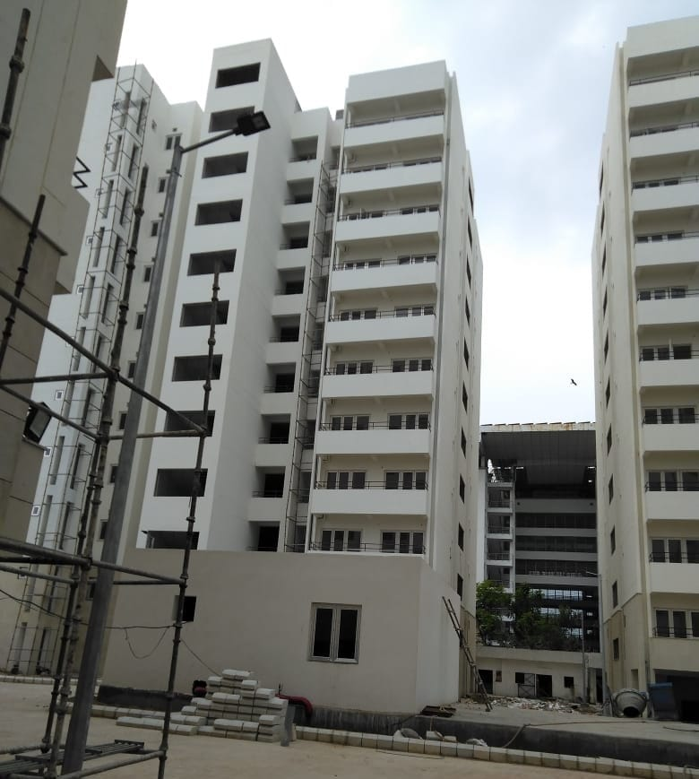
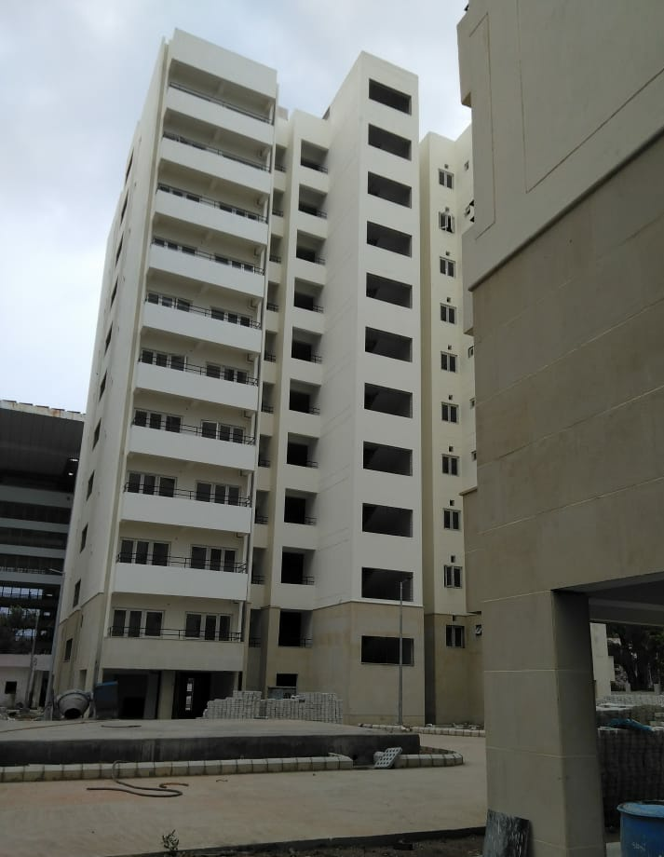
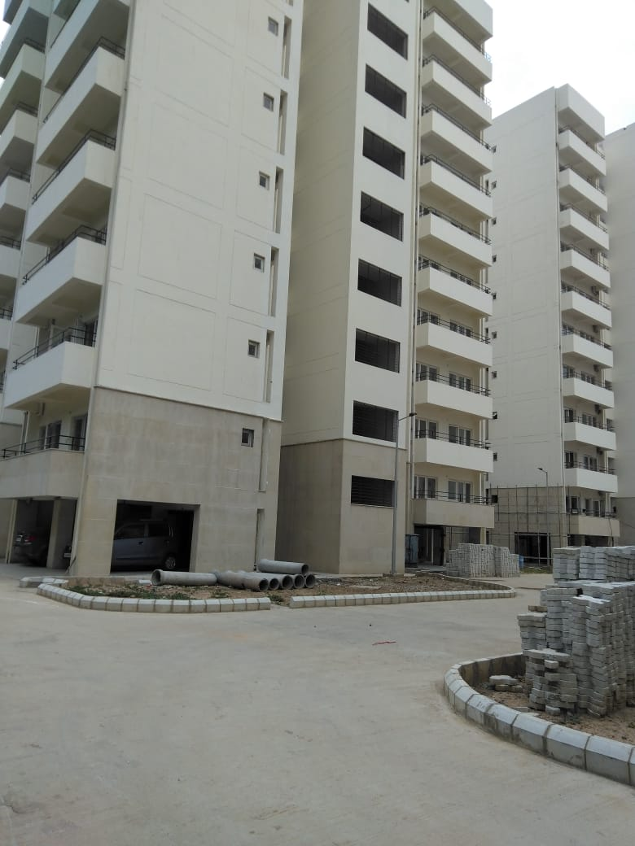
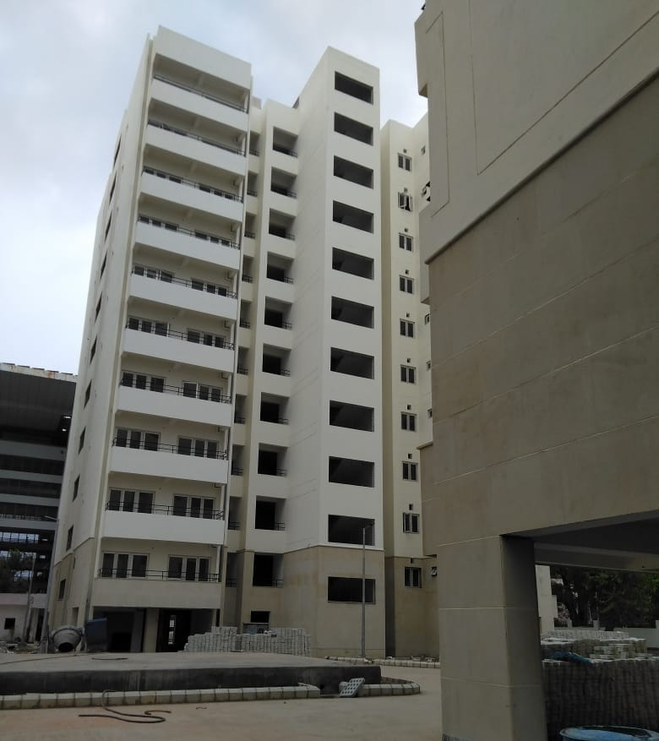
ACHIEVEMENT/ COMPLETED PROJECTS IN THE FY-2021-22
ALIGANJ HOUSING
TOTAL 200 TYPE-II FLATS,
04 TOWERS (50 FLATS PER TOWER)
5 FLATS AT EACH FLOOR
AREA OF EACH FLAT - 54.42 SQM
BEDROOM – 10.20 SQM
DRAWING ROOM – 12.66 SQM
KITCHEN – 4.90 SQM
TOILET – 1.63 SQM
BATHROOM – 1.94 SQM
PASSAGE – 3.45 SQM
10 STORIED 04 TOWERS
STILT FOR PARKING
TENDER COST Rs. 40.33 CR.
STATUS – WORK COMPLETED
TENDERED AMOUNT – RS.40.32 CR.

Slide 3
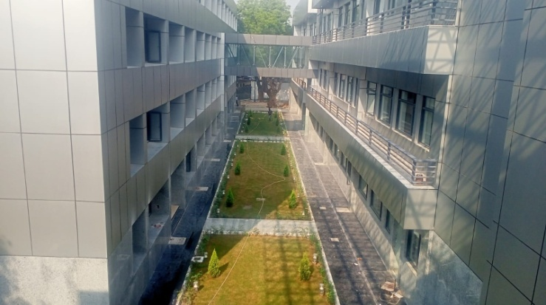
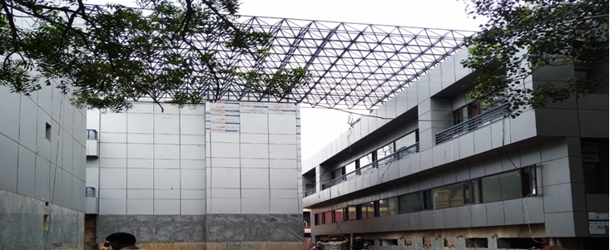
IMPROVEMENT TO VIDYUT BHAWAN
RENOVATION/ MODIFICATION OF BLOCK A,B,C, VIDYUT BHAWAN OFFICE COMPLEX AT DR. APJ ABDUL KALAM ROAD
Stipulated Date of Start : 13.01.2020
Stipulated Date of Completion : 12.07.2020
Actual Date of Start : 04.01.2020
Actual Date of Completion : 21.10.2021
Covered Office Area : 81718 Sq.ft.
Annual Rent Revenue : 41 Crore (Rs.418/ Sqft. / month)
Annual Maintenance : 3.82 Crore (Rs.39/ Sqft./month)
Expected expenditure : Rs.35,00,00,000/-

Slide 4
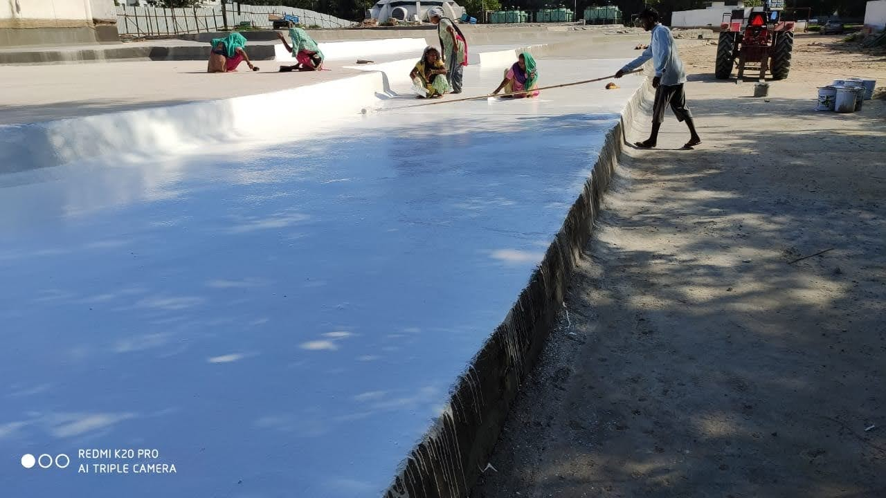
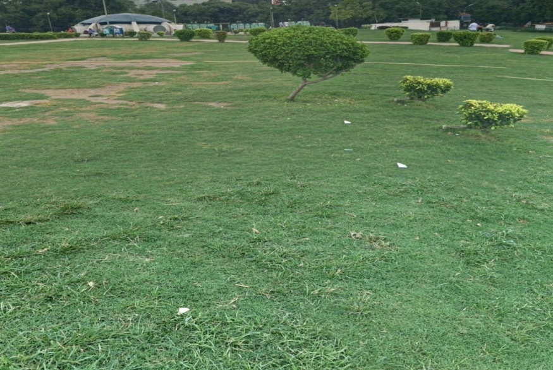
water proofing treatment at the terrace of PALIKA BAZAAR
STATUS
WORK COMPLETED ON 24.08.2021
COST: RS.4.40 CR.

Slide 5
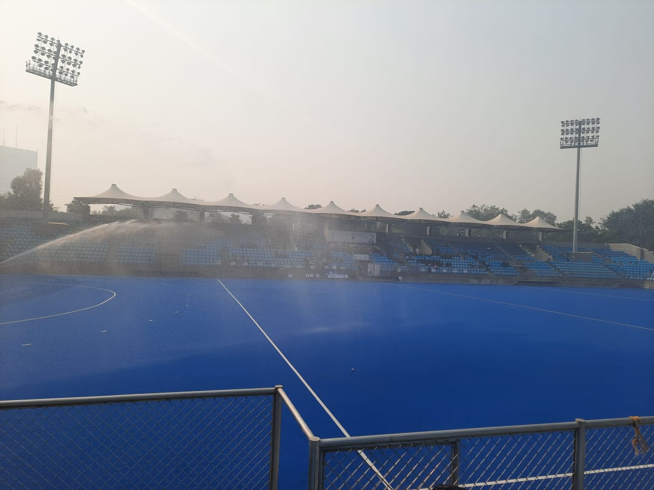
REPLACEMENT OF HOCKEY TURF AND SPRINKLER SYSTEM AT SHIVAJI STADIUM
STATUS
WORK COMPLETED ON 10.06.2021
COST: RS.2.10 CR.

Slide 6
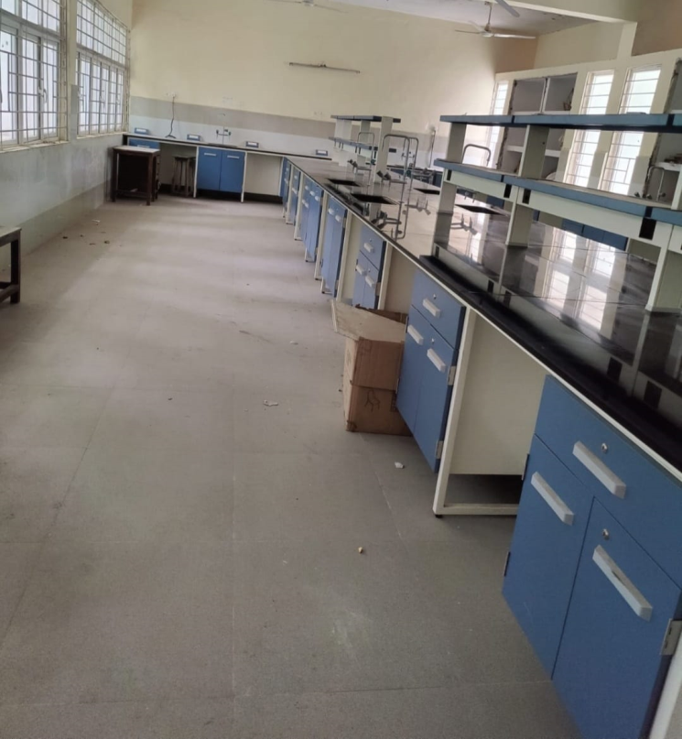
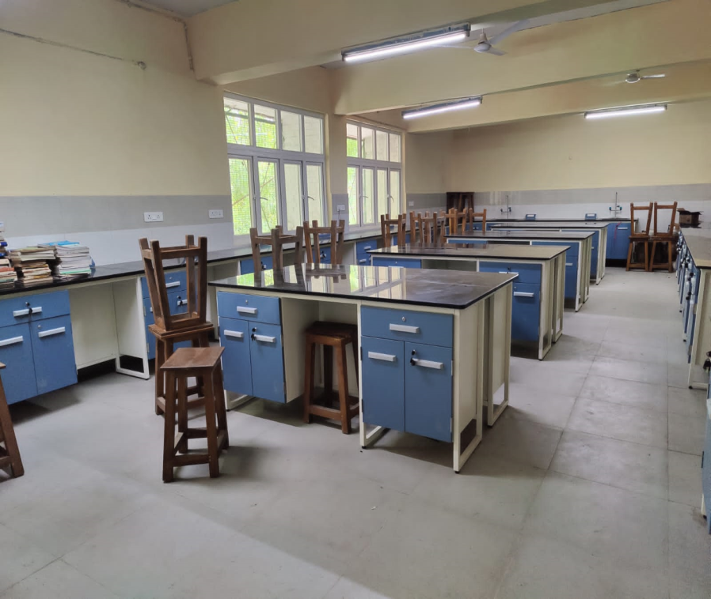
UP-GRADATION OF LABORATORIES IN NDMC/ NAVYUG SCHOOLS
STATUS
WORK COMPLETED
COST: CIVIL WORK RS.1.35 CR.
FURNITURE: RS.7.28 CR.

Slide 7
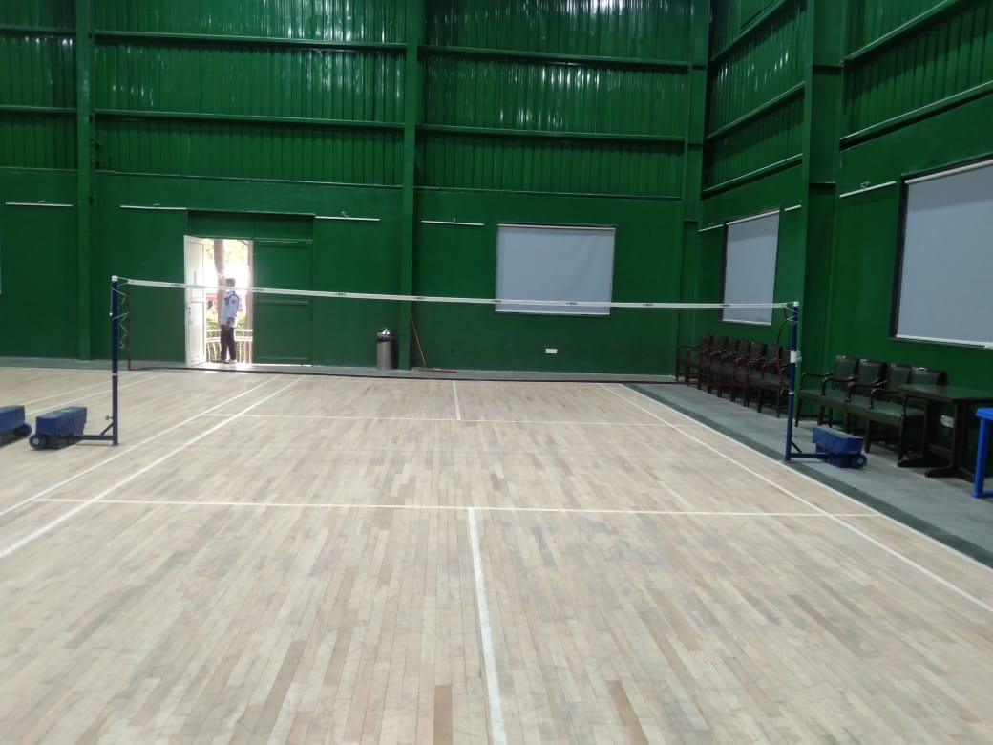
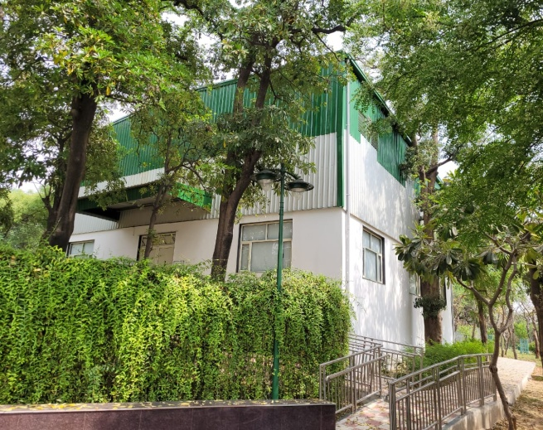
CONSTRUCTION OF SHED FOR COVERING OF OPEN BADMINTON COURT AT PSOI CLUB, SATYA SADAN
STATUS
WORK COMPLETED ON 18.06.2021
COST: RS.67.10 LAKHS

Slide 8
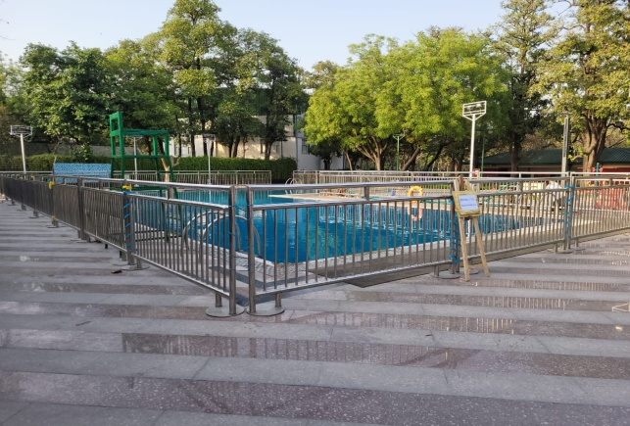
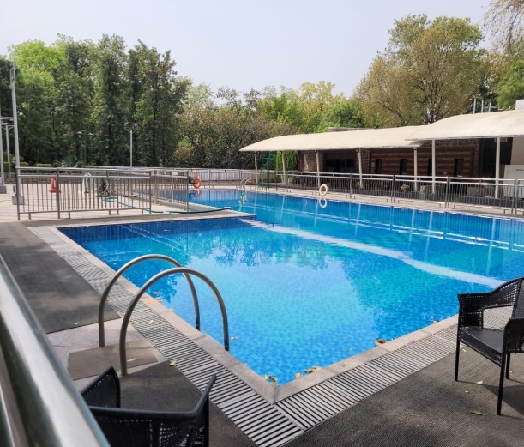
REPLACEMENT OF OLD TILES IN AND AROUND OF SWIMMING POOL WITH GRANITE MOSAIC TILES AND WITH THE PROVISION OF WATER PROOFING TREATMENT AT PSOI CLUB, VINAY MARG
STATUS
WORK COMPLETED ON 01.11.2021
COST: RS.87.32 LAKHS

Slide 9
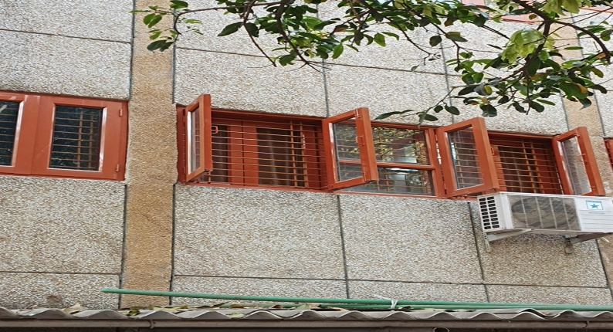
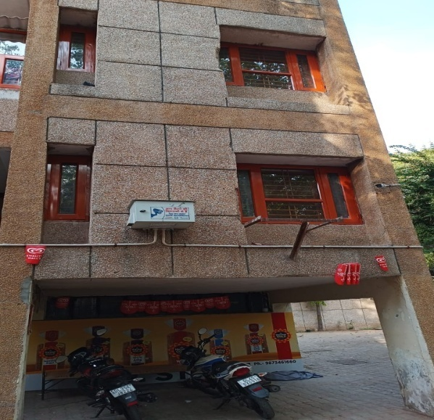
REPLACEMENT OF EXISTING OLD DAMAGED MS WINDOW WITH NEW ALUMINIUM WINDOW IN KAKA NAGAR HOUSING COMPLEX
STATUS
WORK COMPLETED ON 30.12.2021
COST: RS.45.00 LAKHS

Slide 10
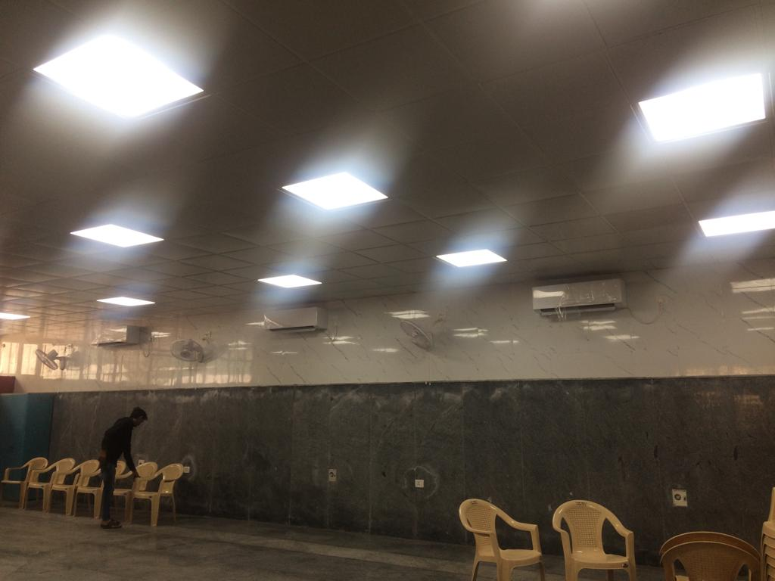
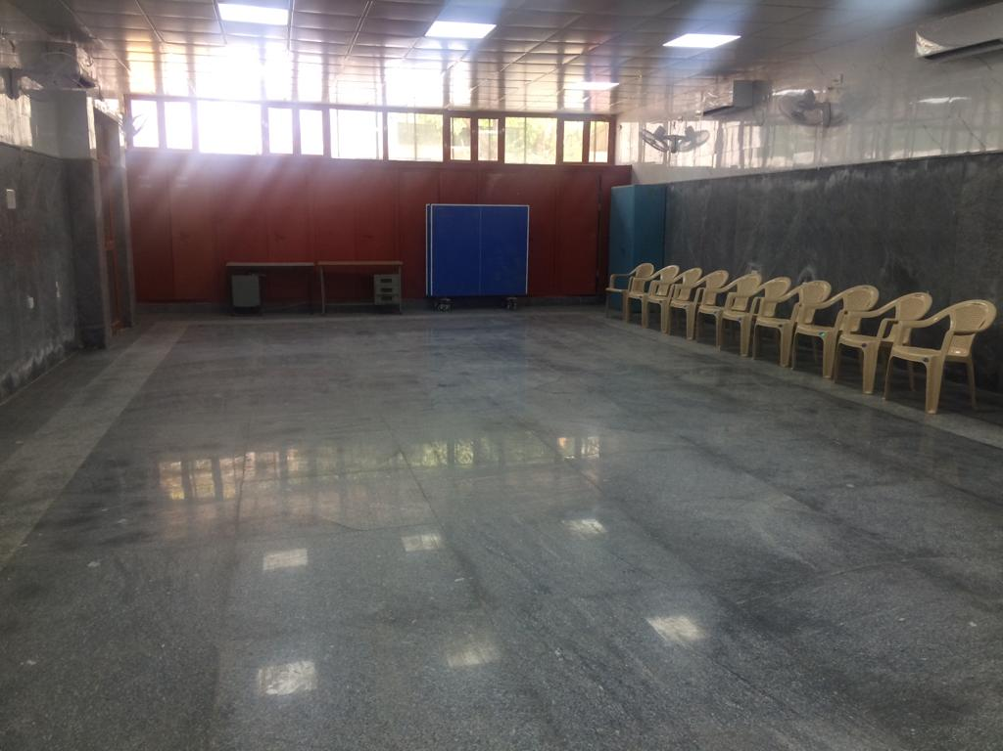
RENOVATION OF COMMUNITY HALL AT ADITYA SADAN, ASHOKA ROAD
STATUS
WORK COMPLETED ON 22.03.2021
COST: RS.11.75 LAKHS

Slide 11
WORK TARGET/BUDGET ANNOUNCEMENT/ONGOING WORK FOR THE FINANCIAL YEAR 2022-23
NAME OF SCHEME ANNOUNCED IN THE BUDGET SPEECH 2022-23 | STATUS
Development of available space at Yashwant Place, Chanakyapuri, New Delhi. Sub head: Construction of Commercial Complex at Yashwant Place, Chanakyapuri, New Delhi. | 1. Council has accorded A/A & E/S amounting to Rs.88,92,49,700/- vide Council Resolution No.6 (A-04) dated 27.04.2017. 2. After due procedure tender were invited and Financial Bid has been opened and M/s. Globe Civil Projects Pvt. Ltd. is found L-1 agency with their tender cost of Rs.93,43,49,562/- i.e. @22.10% below the estimated cost of Rs.119,94,21,774/-. Tender is under scrutiny in Finance Department. 3. The work is likely to be started in August, 2022 and shall be completed by August, 2025.
External Development and Façade Uplifting at Yashwant Place Momos Market, New Delhi. | Work is in progress and will be completed by July, 2022
Proposed Bus Terminus-cum-Commercial Complex near Shivaji Stadium, New Delhi. Sub Head:- Construction of Bus Terminus-cum-Commercial Complex near Shivaji Stadium, New Delhi. | Council has accorded A/A & E/S amounting to Rs.39,60,07,300/- vide Council Resolution No. 10(A-21) dated 21.08.2017. Percentage Rate Tender on e-procurement system has been invited. The bid has been opened on 07.06.2022. Three Agencies participated in the bidding. The case will be placed before Technical Evaluation Committee for Evaluation of bid documents. The work is likely to be start in August 2022 and shall be completed by January, 2024.
Construction of Rain Water Harvesting Pits In NDMC Buildings The work for rain water harvesting pits in 13 Nos. NDMC Buildings and 32 Electric Sub Stations. | Work is in progress and will be completed by January, 2023
Up-Gradation of Laboratories in NDMC/ Navyug Schools (22 Schools/74 labs). | Work completed.
Improvement and Up-Gradation of Palika Bazar Complex. | The work of improvement and up-gradation of Palika Bazar Complex is in progress and will be completed by June, 2022.
Construction of Skill Development Centre at Moti Bagh. | 41% work was completed. 3rd floor roof slab completed. Roof slab of 4th floor Casted. Brick work at 2nd floor and 3rd floor is in progress. Column work 4th & 5th floor is in progress. Tentative date of completion is December 2022.

Slide 12
NAME OF SCHEME ANNOUNCED IN THE BUDGET SPEECH 2022-23 | STATUS
The work of JPN Library at Mandir Marg. | The work is in progress. The ground floor roof has been casted and casting of column of Ist floor is in progress. The target date of completion is December, 2022.
Additional Block at Indira Niketan Working Girls Hostel. | 1. Council has accorded A/A & E/S amounting to Rs.8,15,08,000/- vide Resolution Nos. 28 (A-10) dated 03.01.2020 and 03 (A-01) dated 04.08.2020. 2. After due procedure tender were invited and financial bid opened The financial bid was opened on 06.05.2022, wherein M/s Confoss Construction was found L-1 Bidder at their quoted rate 15.07% below the estimated cost. The quoted amount is Rs.8,02,74,132/-. Tender is under scrutiny. 3. The work is likely to be started in July, 2022 and shall be completed by July, 2023.
Construction of 120 Nos. Type – II Flats at Sector – VII, Pushp Vihar, Saket, New Delhi. | A-B & C-D block has been completed. Road work has been completed and other misc. outer development work is in progress. The case for connection for water and sewer denied by DJB and CPWD. The case is to be taken up with CEO-DJB. STP agenda has been approved by Council. STP NIT has been prepared and under scrutiny in planning.
Construction of 160 Nos. Type – III Flats at Sector – VI, Pushp Vihar, Saket, New Delhi. | 90% Excavation work completed. 90% PCC work under raft completed. 90% Kota stone water proofing work under raft completed. 18% Steel reinforcement work upto Plinth Level completed. 75% RCC work for raft completed. RCC wall work at minus B-2 level is under progress.
Redevelopment of Bapu Samaj Sewa Kendra, P.K. Road, New Delhi | 1. Financial bid has been opened on 29.03.2022. 2. Financial bid has been scrutinized by TEC and the case is submitted for acceptance of L-1 tender by Competent Authority.
Commercialization of Housing Complex at Prithvi Raj Road Market. | Detailed proposal (DPR) is under preparation through FA.
Retrofitting Work To Make The NDMC High Rise Buildings Safe For Seismic Effect. As per the direction of the Hon’ble High Court in W.P. I 434/2015 titled Arpit Bhargava & Anr. Vs North Delhi Municipal Corporation & Ors. | Out of total 25 identified high risk buildings, 23 buildings already get safety certificates from structural consultant. Work of retrofitting is in progress in remaining two buildings.

Slide 13
NAME OF SCHEME ANNOUNCED IN THE BUDGET SPEECH 2022-23 | STATUS
NDMC is planning to renovate the existing markets complexes in its area. | Drawings are being prepared by Architect Department, accordingly estimate will be prepared.
Installation of Lifts In Four Storey NDMC Housing Complexes. | The survey and identification of the buildings were carried out. Due to different location the work is taken up independently and shall be completed in phased manner.
Construction of Veterinary Hospital at Moti Bagh, New Delhi. | Tender opened. Out of three eligible bidders, M/s. Vipul Construction found L-1 with their quoted rates of 25.99% below the estimated cost of Rs.3,42,98,980/- at tender value of Rs.2,53,84,675/-. The case has been sent to Finance Department for their concurrence.
(ii) Up gradation of Casualty and construction of Disaster Ward at CPH. | The work is in progress and likely to be completed by July, 2022.
Up-gradation of Auditorium in 2 schools. Mandir Marg and Sarojini Nagar | The work is in progress and shall be completed by December, 2022.
One Nature based Class room will be set up in each of 10 NDMC/Navyug schools. | A/A & E/S accorded by competent authority for Rs.42.39 lacs. Tender is likely to be called by 15.07.2022 and work is to be awarded by August, 2022 and completion by October, 2022.
Introduction of Bag-Less Pre-Primary And Primary Classrooms. (30 schools) | Tender opened and is under scrutiny Finance. Work is likely to be awarded by July, 2022 and shall be completed by December, 2022.
Renovation and Development Works at NDMC, Palika Kendra Building: Palika Kendra Building is the headquarter of New Delhi Municipal Council. | RFP is being re-called as no agency found eligible. As decided by TEC, RFP is being modified which is under process.
Redevelopment of School Complex of Lodhi Colony into the School of Excellence The project has been approved with an outlay of Rs.97.92 crores and appointment of a consultant has been made. The project is now assessed to be commenced in FY 2022-23. | AIP is under process.
Construction of New Building for Atal Adarsh Bengali Balika Vidyalaya, Gole Market, New Delhi. | The Architectural drawing are under finalization.

Slide 14
NAME OF SCHEME ANNOUNCED IN THE BUDGET SPEECH 2022-23 | STATUS
Construction of 28 Nos. Type-3 flats at Bapu Dham, New Delhi. | Structural drawings have been issued by design division for preparation of DE. Statuary approvals are awaited from Architect Department. Case for revised A/A & E/S is under process. The case is submitted for obtaining approval of the Chairman, NDMC for withdrawal the agenda of A/A & E/S of the PE amounting to Rs.25,99,77,000/- which was to be placed in coming Council meeting due to some changes in the agenda.
Up-gradation/ renovation of Canteen Ground Floor, Palika Kendra Building, New Delhi | Preliminary Estimate amounting to Rs.49.00 lacs has been accorded by the competent authority. DE/ NIT is under process.
Renovation work at Vice chairperson & Members Room at 3rd floor Palika Kendra Building. | Work awarded. Revised drawings have been received from Architect Department recently. Work is being started.
Appointment of consultant for comprehensive renovation work at Convention Centre, NDCC Phase-II, New Delhi. | RFP checked by Main Planning and received back with observations from A.O. (W-II). Reply is being sent.
Renovation of all toilets block of Palika Kendra Building. | The work is in progress.

Slide 15
THANK YOU

